Slide 1

Data Transfers

Slide 2
Getting Started with RC
Daniel Trahan
Email: Daniel.Trahan@Colorado.edu
RC Homepage: https://www.colorado.edu/rc
Slides available for download at:
https://github.com/ResearchComputing/Data_Transfers_Fall_2021

Slide 3
Outline
Getting an RC Account
Navigating the RC Ecosystem
Linux Tools
SCP
SFTP
RSYNC
SSHFS
SMB
Globus Demo
Sharing Data
Getting A Petalibrary Allocation

Slide 4
RC Accounts
Before accessing your resources, Research Computing requires users to obtain specialized RC accounts.
Why?
A lot of CU users do not need access to HPC or Enterprise grade storage
Highly valuable resource!
RC requires the setup of 2-factor authentication
Other institutions utilize RMACC Summit
Accounts can quickly and easily be obtained through our website at www.Colorado.edu/rc

Slide 5
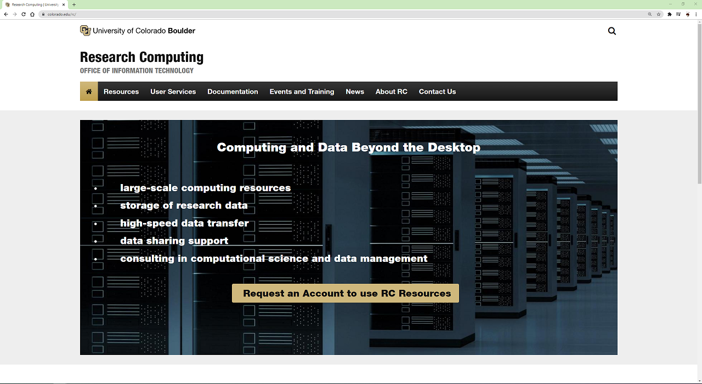
Getting an RC Account
Click here to get started!

Slide 6
Duo Accounts
After requesting your account you will soon be sent an invitation to RC’s Duo 2-factor authentication utility.
You will be prompted to set up a smart device with the Duo application.
Follow the steps prompted by the email invitation to activate your device.
Don’t have a smart Device? No Problem!
RC also offers 2 factor authentication tokens to access your account.
Contact rc-help@colorado.edu for more information

Slide 7
Accessing RC Services
There are numerous ways to access RC Resources from your local machine
Globus (if just managing files!)
Command line (Most common for Jobs)
Jupyterlab
Visualization Cluster
Globus is probably the easiest solution when accessing files your files on RC resources

Slide 8
Access through the Command Line
Other users may find the use of Globus to be overly clunky when wanting to check on their files.
Users can log into RC servers on their local machines by opening a terminal and running the command:
For users given temporary accounts please login with the following command:
ssh <your-username>@login.rc.colorado.edu
ssh <your-username>@tlogin1.rc.colorado.edu

Slide 9
Basic Navigation Commands
Change directories
List contents of a directory
Print current working directory
cd <relative-or-full-path>
ls <optional-path>
pwd

Slide 10
RC Filesystem
As with most Linux distributions, after logging into RC Resources you will be placed on your RC home directory.
RC’s file system is broken up into 4 major components
Home – 2GB
Projects – 250GB
Scratch – 10TB
PL (Petalibrary) - Contact your PI about purchasing PL Space!
Backups occur regularly on Home and Projects.
PL Active capability is coming soon!
Scratch will delete files older than 90 days.

Slide 11
RC File system map
/
/home
/projects
/scratch
/pl
/summit
/your-username
/your-username
/your-username
You start here!
/active
/archive
/your-pl-allocation
/your-pl-allocation

Slide 12
RC Data transfer nodes
In addition to the usual RC login points, we also provide Data transfer nodes for faster transfers.
The upcoming commands can utilized these nodes IF you are on CU's VPN.
Address to transfer to data transfer nodes:
scp file1 <username>@login.rc.colorado.edu:<remote-path>

Slide 13
Command line options (1)
SCP / Secure Copy
scp is a very simple file transfer command that allows users to transfer one file to another remote system.
Useful with small or quick file transfers
SFTP / Secure File Transfer Protocol
sftp is a similarly simple protocol that loads a user into a sftp prompt with both local and remote file systems accessable from a single prompt.
Useful for multiple/repetative small file transfers.
scp file1 <username>@login.rc.colorado.edu:<remote-path>
sftp<username>@login.rc.colorado.edu

Slide 14
Command line options (2)
rsync
rsync is a popular linux utility for updating changed files to a remote filesystem.
Useful when working on a file on both remote and local machines with modifications that need to be updated
Flags:
-v # verbose mode
-r # recursive (directory)
-t # sync based off timestamp
-c # sync changed files based on content
-a # archive mode
rsync -v file1 <username>@login.rc.colorado.edu:<remote-path>

Slide 15
Command line options (3)
sshfs
Mount a remote directory to a local Unix operating system!
Mac and Linux Exclusive:
But can windows do something similar?
smb mounting
Universal mounting protocol that is built into every operating system
Contact RC to get this set up!
sshfs <username>@login.rc.colorado.edu:<path> <local-mountpoint>

Slide 16

OpenOnDemand
GUI approach to RC Resources!
http://ondemand.rc.colorado.edu/
File management
Create, Delete, Move, and Rename
File transfers
Upload and Download
Good for managing your files without interacting with a command line.
Also great for small transfers without interacting with a command line

Slide 17
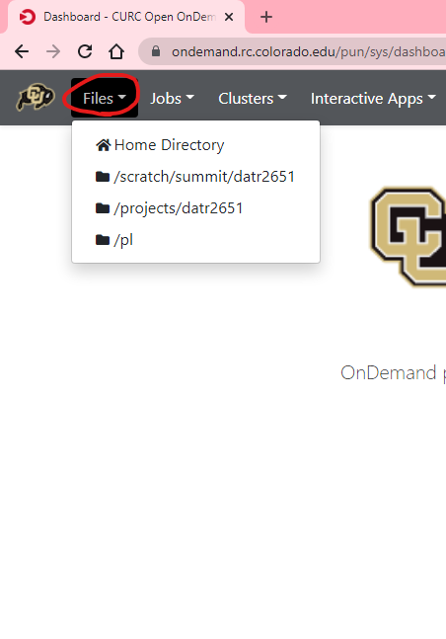
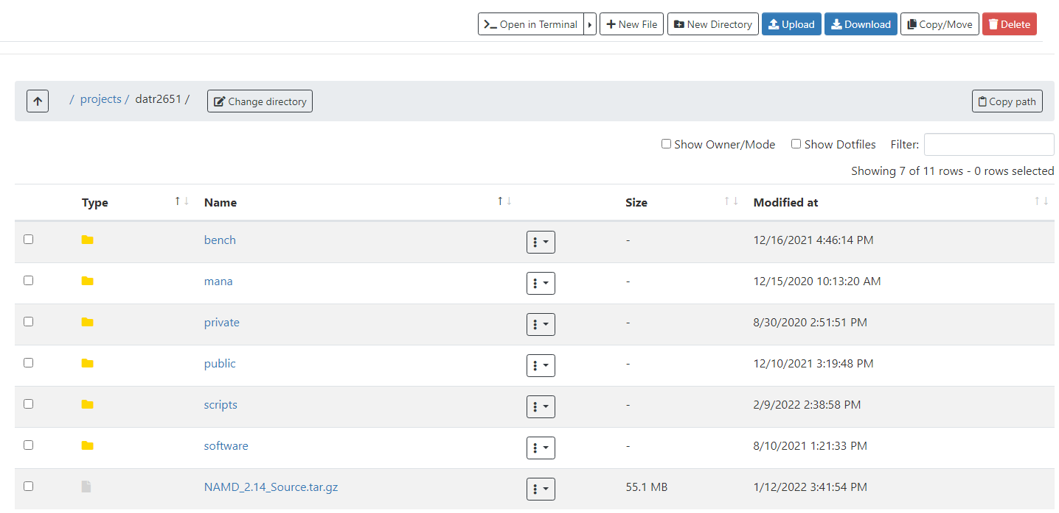

Slide 18

Globus
Globus
By far the most stable and recommended way for data transfers
Fast transfers
Transfers continue if a user disconnects
Web GUI option or Globus Connect Personal
Demo:

Slide 19
Globus Demo (1)
Globus login is simple and quick: https://app.globus.org
Select University of Colorado at Boulder under the dropdown menu
Login with your CU credentials
Continue with onscreen prompts until you are brought to the Globus WebGUI
Installing a Globus Endpoint on your local machine
Navigate down to Endpoints on the sidebar
Click create an endpoint on the top right of the page
Select your operating system and download the installer
Follow the prompts on the installer and complete the installation

Slide 20
Globus Demo (2)
Transferring Files can be done through the GUI
From the File Manager tab:
Click the “Two Panel” view button at the top right.
Click the top left Search bar.
Search “CU Boulder Research Computing” and select the end point.
Sign into Research Computing’s Endpoint
Click the right search bar
On the ‘Your Collections’ tab, choose the endpoint you created
Transfer your files!

Slide 21
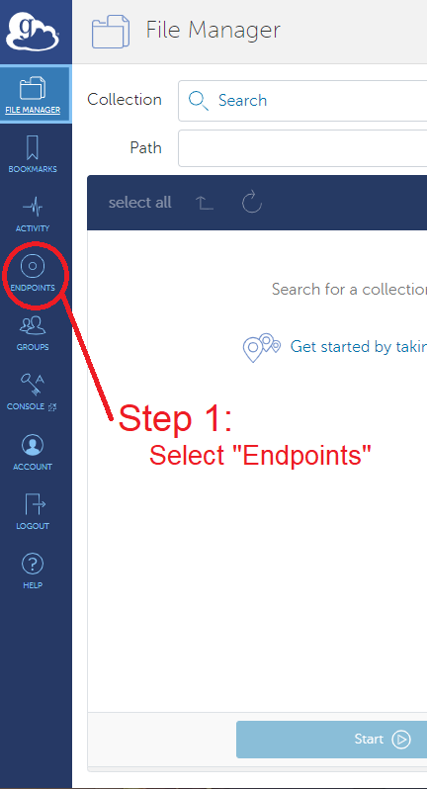
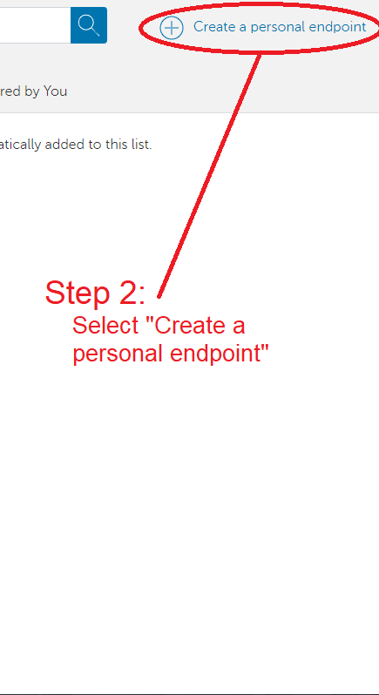
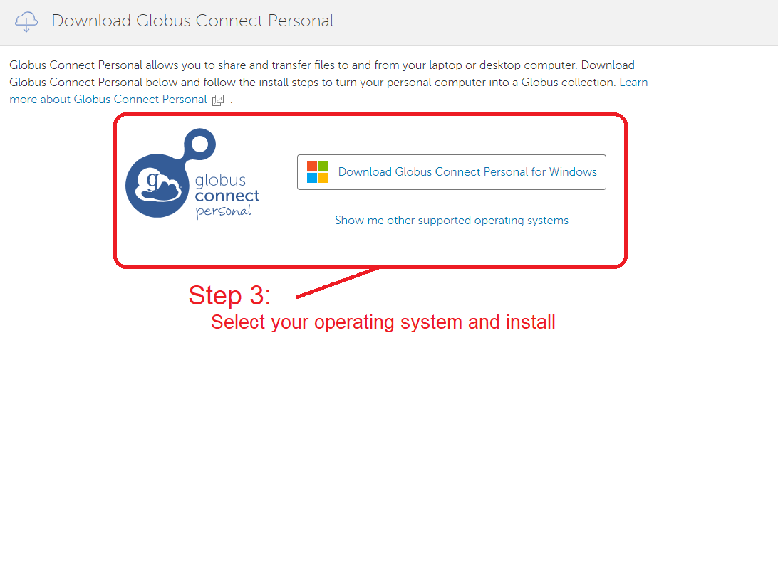

Slide 22
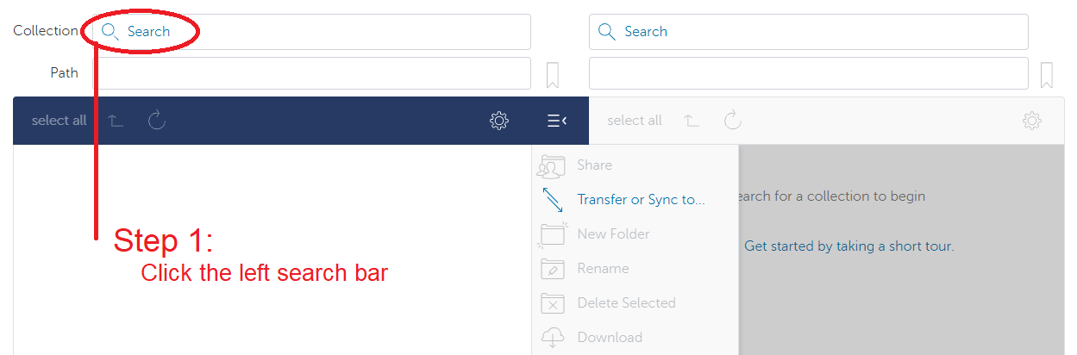
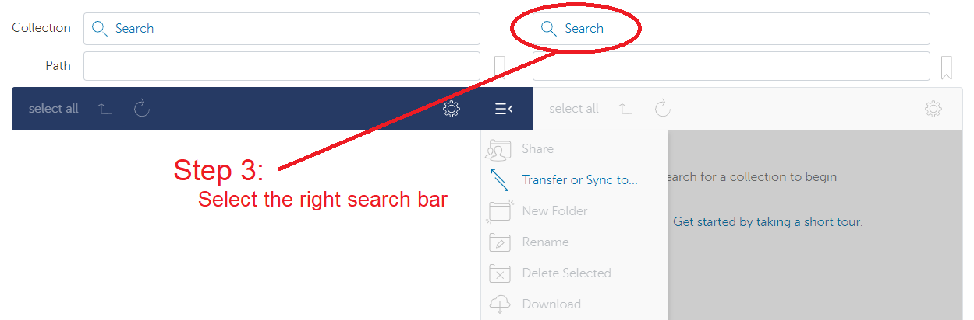
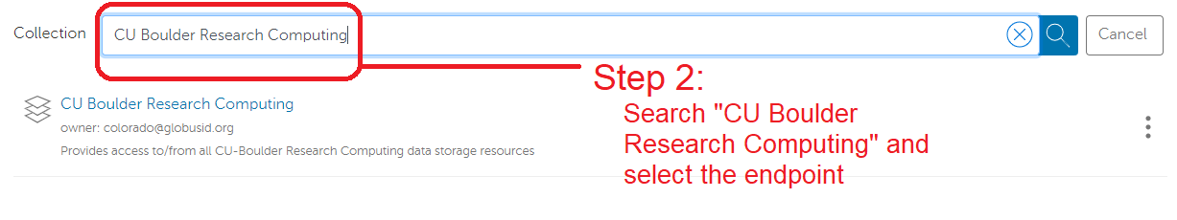
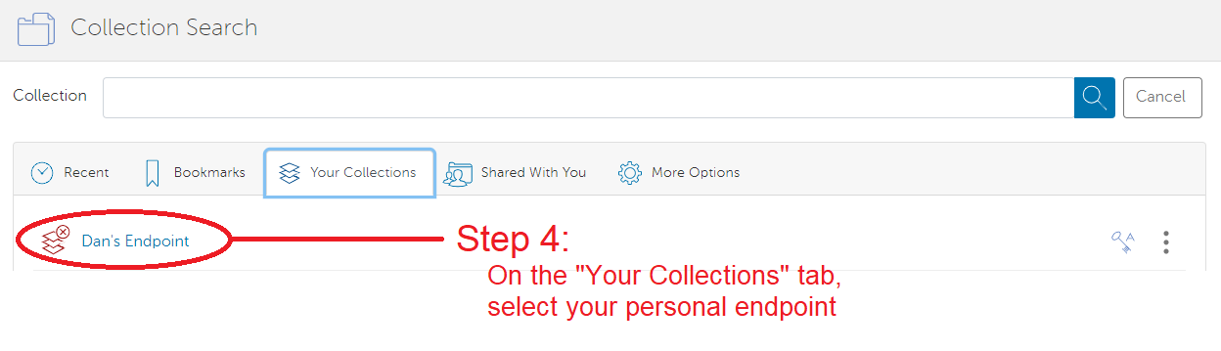

Slide 23
Sharing Data
Other RC Users
To share files with other RC users. Simply contact RC with a list of users you would wish to allow access.
RC will place the chosen users in the owner’s group
The owner can then set up permissions in the space
On premise collaborators can also access Petalibrary files with Globus Shared Endpoints
Off-premise collaborators
Off premise collaborators can only access Petalibrary files through Globus Shared Endpoints

Slide 24
Unix Groups
Unix Groups
3 Levels of permissions:
User
Group
Other
All users have a group associated with their username
Permissions can be set for an individual file with the chmod command
chmod g+rx file.exe

Slide 25
Globus Shared Endpoints
Globus offers ‘shared endpoints’ which don’t require a user to have an account with RC.
RC provides this capability for easy access of Data.
Petalibrary Exclusive!
Generates a shared collection that can be accessed with a link.
Can assign various permissions to specific users or all users withing Globus
More information on here: https://docs.globus.org/how-to/share-files/

Slide 26
Data Publishing with Petalibrary
Using Globus shared endpoints can be a great way to publish your data while maintaining the convenience of having it Petalibrary.
Example: https://scholar.colorado.edu/concern/datasets/9593tw13k

Slide 27
Petalibrary Notes
curc-quota – Research Computing tool to monitor disk usage.
Provides detailed summary of your core storage
Provides detailed summary of scratch space on compile and compute nodes
Also lists current capacity of all Petalibrary allocations you have access to
Confidential Data is unsupported and should not be stored on Petalibrary
[userXXXX@login12 ~]$ curc-quota

Slide 28
Thank you!
Please fill out the survey: http://tinyurl.com/curc-survey18
Contact information: rc-help@Colorado.edu
Slides: https://github.com/ResearchComputing/Data_Transfers_Fall_2021

